Slide 1
Descriptive Statistics: Processing and Analysis of Data

Slide 2
1 Statistics: Descriptive and Inferential
2 Data presentation.
3 Data characteristics: Descriptive statistics
4 Probability: Basic conepts and distribution
6 Sampling Distributions
7 Estimation.
8 Hypothesis Testing
10 Categorical Data.Analysis and Analysis of variance
11 Simple Linear regression and correlation
Multivatiate analysis

Slide 3
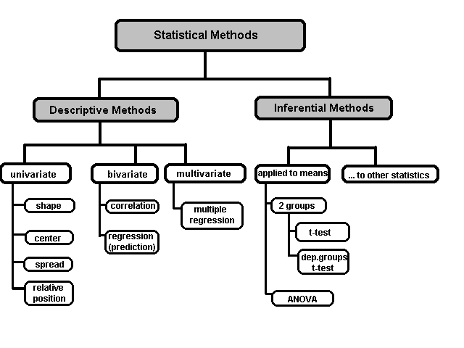

Slide 4
Source
Destination
Information
(Data, Information, Knowledge) these terms are loosely used
Data > Any recorded event
Information > Acquired data
Knowledge > Useful information
Data becomes information if they are of interest to an observer, who makes effort to acquire, and then the useful data is knowledge
Information >Transmission + Reception = Communication
Storage
Utilization

Slide 5
Statistics is a collection of tools used for converting raw data into information to help decision makers in their works.
Descriptive Statistics
Gives numerical and graphic procedures to summarize a collection of data in a clear and understandable way.
Inferential Statistics
Provides procedures to draw inferences about a population from a sample, mainly concerned with estimation of parameter values and testing of hypothesis

Slide 6
Basic terminology
Population: the whole set of a “universe”
Sample: a sub-set of a population
Parameter: an unknown “fixed” value of population characteristic
Statistics: a known/calculable value of sample characteristic representing that of the population.
Randomness: Many things occur by pure chances…rainfall, disease, birth, death,..
Variability: Stochastic processes bring in them various different dimensions, characteristics, properties, features, etc., in the population
Statistical analysis methods have been developed to deal with these very nature of real world.

Slide 7
Types of data
Nominal data: data that has names. eg: rock types (sedimentary, igneous or metamorphic).
Ordinal data: data that can be placed in ascending or descending order. eg: settlement type (city, town, village & hamlet).
Interval data: data with no true zero. Very uncommon so don’t worry about it.
Ratio data: most numerical data.

Slide 8
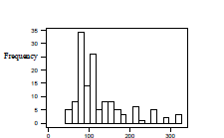
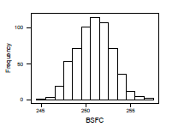
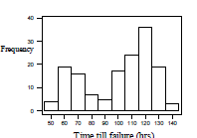
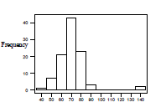
Typical data distribution
Normal
Skewed
Number of incidents
Number of incidents
Bimodal
Outlier
Number of incidents
Number of incidents

Slide 9
Measures of data Characteristics
Measures of Central Tendency
Mean (Arithmetic, Geometric and Harmonic), Median, Mode
Measures of Variability
Range, Standard Deviation, Variance, Coefficient of Variation
Measures of Relative Standing
Percentiles, Quartiles
Measures of Linear Relationship
Covariance, Correlation, Least Squares Line

Slide 10
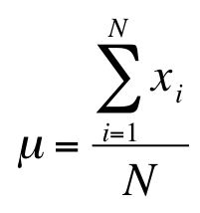
Mean
The arithmetic mean for a data stream
Mean is seriously affected by extreme values called “outliers”. Ex: As soon as a billionaire moves into a neighborhood, the average household income increases beyond what it was previously!

Slide 11
Mean with frequency distribution for cluster data
Mean of frequency distribution is also thought of as weighted mean, where replace f_{i} by w_{i}
Scores (x) | 2 | 5 | 6 | 8
Frequency (f) | 1 | 3 | 4 | 2
Then

Slide 12
Mean is a measure of central tendency and called statistical average. If A is the assumed average, then

Slide 13
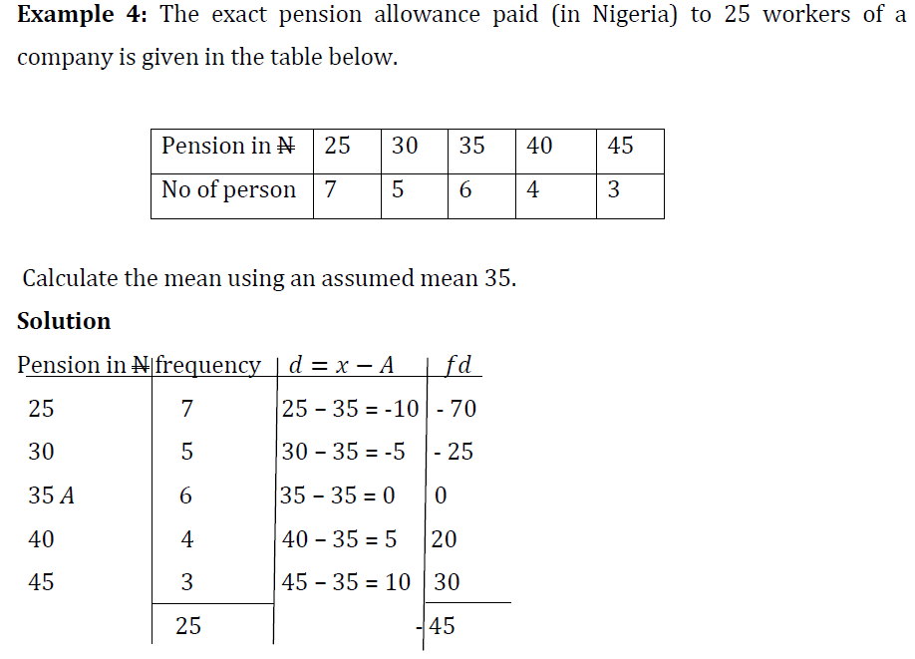
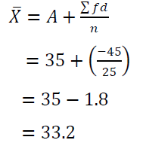

Slide 14
Geometric mean and Harmonic mean
Geometric mean g
GM of 8,1,6
Harmonic Mean h is the reciprocal of arithmetic mean
HM of 8,1,6
Data = 8,1,6, AM = 5, GM = 3.63 and HM = 2.32 AM>GM>HM
GM is used when there is outliner (extreme value), HM is not used

Slide 15
Measures of Central Location: Median and Mode
The median is calculated by placing all observations in a particular order; the observation that falls in the middle is the median.
Data: {0, 7, 12, 5, 14, 8, 0, 9, 22} N=9 (odd)
Sort them bottom to top, find the middle:
0 0 5 7 8 9 12 14 22
Data: {0, 7, 12, 5, 14, 8, 0, 9, 22, 33} N=10 (even)
Sort them bottom to top, the middle is the
simple average between 8 & 9:
0 0 5 7 8 9 12 14 22 33
median = (8+9) ÷2 = 8.5
Sample and population medians are computed the same way.
.

Slide 16
Mode
The mode of a set of observations is the value that occurs most frequently. A set of data may have one mode (or modal class), or two, or more modes.
In the case where data is available in the form of a frequency distribution, the mode where is the median and M is the mean of the given distribution of all mean.

Slide 17
Mean, Median, Mode
Measure | Advantages | Disadvantages
Mean (Sum of all values ÷ no. of values) | ∗ Best known average ∗ Exactly calculable ∗ Make use of all data ∗ Useful for statistical analysis | ∗ Affected by extreme values (outlier) Can be absurd for discrete data (e.g. Family size = 4.5 person) ∗ Cannot be obtained graphically
Median (middle value) | Not influenced by extreme values Obtainable even if data distribution unknown Unaffected by irregular class width ∗ Unaffected by open-ended class | Needs interpolation for group/ aggregate data (cumulative frequency curve) May not be characteristic of group when: (1) items are only few; (2) distribution irregular ∗ Very limited statistical use
Mode (most frequent value) | ∗ Unaffected by extreme values ∗ Easy to obtain from histogram ∗ Determinable from only values near the modal class | Cannot be determined exactly in group data ∗ Very limited statistical use

Slide 18
Measure of Dispersion: Range
The range is the simplest measure of variability, calculated as:
Range = Largest observation – Smallest observation
Data: {4, 4, 4, 4, 50} Range = (50-4) = 46
Data: {4, 8, 15, 24, 39, 50} Range = (50-4) = 46
The range is the same in both cases,
but the data sets have very different distributions…

Slide 19
Mean deviations
Mean deviation from the mean
Mean deviation from the median
Mean deviation from the mode

Slide 20
Standard Deviation
Standard deviation is most widely used measure of dispersion of data, defined as the square root of the average of squares of deviation. It can be obtained form arithmetic average.
Variance =
Coefficient of variation/dispersion
This is a dimension less quantity that measures the relative variation between two data sets observed in different units. The distribution with smaller C.V is said to be better.

Slide 21
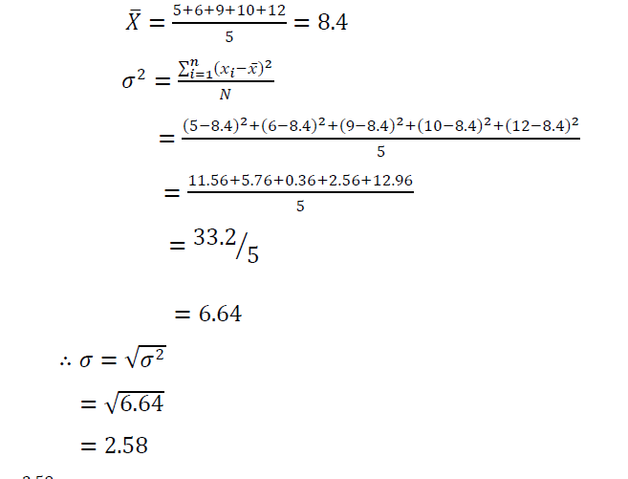
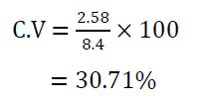
Given the data 5, 6, 9, 10, 12. Compute the variance, standard deviation and coefficient of variation

Slide 22

Measurement of symmetry: Mean, Median, Mode
If a distribution is symmetrical, the mean, median and mode may coincide…
If a distribution is asymmetrical, say skewed to the left or to the right, the three measures may differ
median
mode
median
mode
mean
mean
Mode (occurrence frequency), median is related to middle position and mean is the average (value) . Skew = (Mean-Mode)

Slide 23
Skewness
negative skew
positive skew
Mode
Mean
Median
Z M Xbar

Slide 24
Skewness
Measures asymmetry of data
Positive or right skewed: Longer right tail
Negative or left skewed: Longer left tail

Slide 25
Moments
Given n observations and an arbitrary constant A,
1st moment about A is defined as,
2nd moment about A is defined as,
r- th moment about A is defined as,
Evidently, moment about 0 is the mean
Similarly 1st moments about mean is
2nd moment about mean is variance

Slide 26
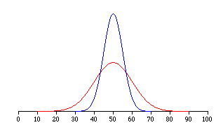
Measures of Symmetry : Kurtosis
Measures of central location fail to tell the whole story about the distribution; that is, how much are the observations spread out around the mean value?
For example, two sets of class grades are shown. The mean (=50) is the same in each case…
But, the red class has greater variability than the blue class.
A measure is given by kurtosis

Slide 27
Kurtosis
Measures peakedness of the distribution of data. The kurtosis of normal distribution is 0.-

Slide 28
Kurtosis
Kurtosis of a random variable x with mean μ and variance σ² is defined as, (Mean-Mode)/standard deviation.
Alternatively,
is the 4th central moment and σ is the standard deviation
Kurtosis is a measure of whether the data are peaked or flat relative to a normal distribution.
That is, data sets with high kurtosis tend to have a distinct peak near the mean, decline rather rapidly, and have heavy tails.
Data sets with low kurtosis tend to have a flat top near the mean rather than a sharp peak.
A uniform distribution would be the extreme case.

Slide 29
Describing data
 | Moment | Non-mean based measure
Center | Mean | Mode, median
Spread | Variance (standard deviation) | Range (max-min), Inter quartile range (1st-3rd quartile)
Skew | Skewness | --
Peaked | Kurtosis | --

Slide 30
Relative standing: Percentiles
Percentile of value x = ((number of values < x)/ total number of values) x100. (round the result to the nearest whole number)
Suppose that in a class of 25 students who obtained the following marks (ordered in ascending order)
12th position
42, 59, 63, 67, 69, 69, 70, 73, 73, 74, 74, 74, 77, 78, 78, 79, 80, 81, 84, 85, 87, 89, 91, 94, 98
If a student received 77,
percentile of 77 = (12/25)x100 = 48

Slide 31
Percentiles
75
The pth percentile is a number such that p% of the observations of the data set fall below and (100 - p)% of the observations fall above it.

Slide 32
Relative Standing: Quartile
A quartile is any of the three values which divide the sorted data set into four equal parts, so that each part represents ¼ th of the sample or population.
first quartile (designated Q1) = lower quartile
cuts off lowest 25% of data (25th percentile )
second quartile (designated Q2) = median
cuts data set in half (50th percentile )
third quartile (designated Q3) = upper quartile
cuts off highest 25% of data, or lowest 75% (75th percentile )
The difference between the upper and lower quartiles is called the inter quartile range.

Slide 33
Relative Standing
Let’s separate the 25 class grades into four quartiles.
Step 1 – order the data in ascending order
42, 59, 63, 67, 69, 69, 70, 73, 73, 74, 74, 74, 77, 78, 78, 79, 80, 81, 84, 85, 87, 89, 91, 94, 98
L₂₅
Q₁
Q₂
Q₃
Now find the 3 locators L₂₅, L₅₀, L₇₅,
L₂₅ = (25/100) * 25 = 6.25
L₅₀ = (50/100) * 25 = 12.5
L₇₅ = (75/100) * 25 = 18.75
7
Round fraction part up to the next integer
13
19

Slide 34
Relative Standing
Other measures of relative standing include:
Inter quartile range (IQR) = Q₃ - Q₁
Semi-inter quartile range = (Q₃ - Q₁)/ 2
Mid quartile = (Q₃ + Q₁)/2
10 – 90 percentile range = P₉₀ - P₁₀
For the data on the previous page we have:
IQR = 84 – 70 = 16
Semi IQR = (84 – 70)/2 = 8
Mid quartile = (84 + 70)/2 = 77
Measures of variation
Measure of central tendency

Slide 35
Sampling

Slide 36
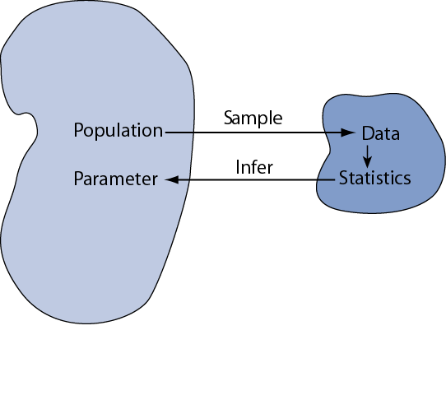
Statistical inference
Statistical inference is the act of generalizing from a sample to a population with calculated degree of certainty.
We want to learn about population parameters…
…but we can only calculate sample statistics
?
µ
Population mean
Mean of samples
A population is a whole, and a sample is a fraction of the whole.
A population is a collection of all the elements we are studying and about which we are trying to draw conclusions. Such a population is often referred to as the target population. A sample is a collection of some, but not all, of the elements of the population

Slide 37
Sampling
Sampling is :
Collecting sample data from a population and
Estimating population parameters
Sampling is an important tool in decisions since it is an effective and efficient way obtaining information about the population.
How good is the estimate obtained from the sample?
The means of multiple samples of a fixed size n from some population will form a distribution called the sampling distribution of the mean
The standard deviation of the sampling distribution of the mean is called the standard error of the mean

Slide 38
Key Sampling issues are:
Sample Design (Planning)
Sampling Methods (Schemes)
Sampling Error
Sample Size Determination.
Confidence level and significance level.
Sample Design (Sample Planning) describes:
Objective of Sampling
Target Population
Population Frame
Method of Sampling
Statistical tools for Data Analysis

Slide 39
Sampling Statistics
Sampling definition: Sampling is a technique of selecting individual members or a subset of the population to make statistical inferences from them and estimate characteristics of the whole population.
Sampling statistics are statistics that are based on values that are created by repeated sampling from a population,
such as:
Mean of the sampling means
Standard Error of the sampling mean
Sampling distribution of the means

Slide 40


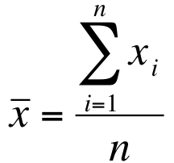
Sample mean
When referring to the number of observations in a population, we use uppercase letter N
When referring to the number of observations in a sample, we use lower case letter n
The arithmetic mean for a population is denoted with Greek letter “mu”:
The arithmetic mean for a sample is denoted with an “x-bar”:
…is seriously affected by extreme values called “outliers”. Ex: As soon as a billionaire moves into a neighborhood, the average household income increases beyond what it was previously!
Population Mean
Sample Mean

Slide 41
What is an outlier?
Observations inconsistent with rest of the dataset – Global Outlier
Special outliers – Local Outlier
Observations inconsistent with their neighborhoods
A local instability or discontinuity

Slide 42

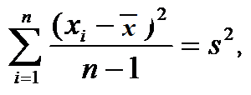
Dispersion of sampled data : Standard deviation and Variance
= mean of population
N = number of observations in population
n = number of observations in sample
Variance of population
Standard deviation σ
Variance of a sample
Constituted from a
Population
Degrees of freedom
Standard deviation s
In statistics, the term degrees of freedom (df) is a measure of the number of independent pieces of information on which the precision of a parameter estimate is based.

Slide 43



Mean & Variance
Population Mean
Number of books =12,
Chapters in books are
given
Variance, where standard deviation is σ
Sample Mean
Sampled alternatively
Sample Variance (how it differs from the mean)
Standard deviation is s
Sample Variance (shortcut method used in software based calculation)

Slide 44
Calculation of Sample Variance
Sample mean:
Subj
Score (x)
Deviation
(dev)²
1
216
22.7
515.29
(216-193.3 )
2
144
-49.3
2430.49
Sample variance S²:
3
183
-10.3
106.09
4
138
-55.3
3058.09
5
212
18.7
349.69
6
180
-13.3
176.89
Standard deviation s
7
200
6.7
44.89
8
264
70.7
4998.49
9
203
9.7
94.09
Σ=1740
Σ=0
Σ=11774.01

Slide 45
Coefficient of Variation
Standard deviation and variance are the measure of absolute variations and depend on the scale of measurement. To compare the variance of several dataset relative variance needs to be assessed. This is given by Coefficient of Variation CV.
The formula for combined variance of two groups is given by,
Mean

Slide 46
Basic Statistical data analysis
Example:
Sample of student ages:
19, 21, 21, 24, 30, 20
Sample size:
n = 6
df = 5
√n = 2.45
Mean age:
mean = 19 + 21 + 21 + 24 + 30 + 20 / 6
mean = 22.5
x | n | mean | (x–mean) | (x-mean)²
19 | 6 | 22.5 | -3.5 | 12.25
21 | 6 | 22.5 | -1.5 | 2.25
21 | 6 | 22.5 | -1.5 | 2.25
24 | 6 | 22.5 | 1.5 | 2.25
30 | 6 | 22.5 | 7.5 | 56.25
20 | 6 | 22.5 | -2.5 | 6.25
 |  |  | ∑ | 81.5
Variance of the mean:
s² = 81.5 / 5
s² = 16.3
Standard Deviation of the mean:
SD² = √ 16.3
SD = 4.04
Standard Error of the mean:
SE = SD/√n = 4.04 / 2.45
SE = 1.65
Coefficient of Variation:
CV = SD/mean= 4.04 / 22.5
CV = 0.18 or 18%

Slide 47
Sampling methods

Slide 48
Sampling Methods (Sampling Schemes)
Subjective Methods (Non probabilistic, where the probability cannot be determined)
Judgmental Sampling
(Purposive sampling)
Convenience Sampling
(Haphazard sampling)
- Quota sampling
Probabilistic Methods (any data has equal probability of selection)
Simple Random Sampling
Systematic Sampling
Stratified Sampling
Cluster Sampling

Slide 49
Sampling: Design
Probability sampling: Probability sampling is a sampling technique where a researcher sets a selection of a few criteria and chooses members of a population randomly. All the members have an equal opportunity to be a part of the sample with this selection parameter.
Non-probability sampling: In non-probability sampling, the researcher chooses members for research at random. This sampling method is not a fixed or predefined selection process. This makes it difficult for all elements of a population to have equal opportunities to be included in a sample.

Slide 50
Probability sampling
Uses of probability sampling
Reduce Sample Bias: The bias in the sample derived from a population is negligible to non-existent. Probability sampling leads to higher quality sampled data as the sample appropriately represents the population.
Diverse Population: When the population is vast and diverse, it is essential to have adequate representation so that the data is not skewed towards one demographic.
Create an Accurate Sample: Probability sampling helps the researchers plan and create an accurate sample. This helps to obtain well-defined data.

Slide 51
Non-probability sampling
Uses of non-probability sampling
:
Create a hypothesis: Researchers use the non-probability sampling method to create an assumption when limited to no prior information is available. This method helps with the immediate return of data and builds a base for further research.
Exploratory research: Researchers use this sampling technique widely when conducting qualitative research, pilot studies, or exploratory research.
Budget and time constraints: The non-probability method when there are budget and time constraints, and some preliminary data must be collected.

Slide 52
 | Probability Sampling Methods | Non-Probability Sampling Methods
Definition | Probability Sampling is a sampling technique in which samples from a larger population are chosen using a method based on the theory of probability. | Non-probability sampling is a sampling technique in which the researcher selects samples based on the researcher’s subjective judgment rather than random selection.
Alternatively Known as | Random sampling method. | Non-random sampling method
Population selection | The population is selected randomly. | The population is selected arbitrarily.
Nature | The research is conclusive. | The research is exploratory.
Sample | Since there is a method for deciding the sample, the population demographics are conclusively represented. | Since the sampling method is arbitrary, the population demographics representation is almost always skewed.
Time Taken | Takes longer to conduct since the research design defines the selection parameters before the market research study begins. | This type of sampling method is quick since neither the sample or selection criteria of the sample are undefined.
Results | This type of sampling is entirely unbiased and hence the results are unbiased too and conclusive. | This type of sampling is entirely biased and hence the results are biased too, rendering the research speculative.
Hypothesis | In probability sampling, there is an underlying hypothesis before the study begins and the objective of this method is to prove the hypothesis. | In non-probability sampling, the hypothesis is derived after conducting the research study.

Slide 53
Probability Sampling: Methods
Simple Random Sampling
refers to a method of selecting items from a population such that every possible sample of a specified size has an equal chance of being selected
with or without replacement
Stratified Sampling Method:
Population is divided into natural subsets (Strata)
Items are randomly selected from stratum proportional to the size of stratum.
The questions are: How to form strata ? How items be selected from stratum? What will be the sample size?

Slide 54
Stratified Sampling Example
Population
Cash holdings of All Financial Institutions in the Country
Stratified Population
Stratum 1
Large Institutions
Medium Size Institutions
Small Institutions
Select n₁
Stratum 2
Select n₂
Stratum 3
Select n₃
Stratified Sample of Cash Holdings of Financial Institutions
If P_{i} represents proportional population included in stratum i, and n is the total number of sample size , the number of elements selected from stratum i = n.P_{i}

Slide 55
Example
Let us suppose that we want a sample of size n = 30, to be drawn from a population of size N = 8000 which is divided into three strata of size N₁ = 4000, N₂ = 2400 and N₃ = 1600. Adopting proportional allocation, samples to be tankan from each strata are
For strata with N₁ = 4000, we have P₁ = 4000/8000 ; and hence n₁ = n . P₁ = 30 (4000/8000) = 15
Similarly, for strata with N₂ = 2400, we have n₂ = n . P₂ = 30 (2400/8000) = 9, and
for strata with N₃ = 1600, we have n₃ = n . P₃ = 30 (1600/8000) = 6.

Slide 56
Stratified Sampling Example
If the strata differ not only in size , but also in variability the optimum allocation (disproportionate) using standard deviation is considered
Stratum sampling cost: Usually cost is proportional to variate. Therefore root over of the cost C is introduced

Slide 57
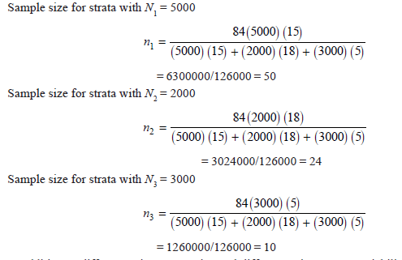
A population is divided into three strata so that N₁ = 5000, N₂ = 2000 and N₃ = 3000. Respective standard deviations are:
σ₁ = 15, σ₂ = 18 and σ₃ = 5. How should a sample of size n = 84 be allocated to the three strata, using disproportionate sampling design?

Slide 58
Cluster Sampling
Cluster sampling refers to a method by which the population is divided into groups, or clusters, that are each intended to be mini-populations. A random sample of m clusters is selected.
Mid-Level Professors by Location for a city
1
2
3
4
5
6
7
42
22
105
20
36
52
76

Slide 59
Example : Cluster sampling (probability proportional to size)
City number | No of stores | Cumulative total | Sample
1 | 35 | 35 | 10
2 | 17 | (35+17)=52
3 | 10 | 52+10)=62 | 60 (10+50)
4 | 32 | 94
5 | 70 | 164 | 110 | 160
6 | 28 | 192
7 | 26 | 218 | 210
8 | 19 | 237
9 | 26 | 263 | 260
10 | 66 | 329 | 310
11 | 37 | 366 | 360
12 | 44 | 410 | 410
13 | 33 | 443
14 | 29 | 472 | 460
15 | 28 | 500
Number of departmental stores in 15 cities are 500 as shown. Select 10 stores in each city using cities as clusters and within cluster select samples proportional to size.
Given starting point 10.
To select 10 stores from 500 stores, the interval is 50

Slide 60
Data distribution : Probability distribution

Slide 61
Typical data distribution
Normal
Skewed
Number of incidents
Number of incidents
Bimodal
Outlier
Number of incidents
Number of incidents

Slide 62
Data distribution
The mathematical rule (or function) that assigns a given numerical value to each possible outcome of an experiment in the sample space of interest. Random variables can be discontinuous or continuous
• Binomial
• Poisson
• Uniform
• Normal
• Exponential
The first two are discrete and the last three continuous data distribution .
Gamma distribution

Slide 63


The Binomial Distribution : Bernoulli Random Variables
• A set of n experiments or trials are conducted.
• Each trial could result in either a success (S) or a failure.(F)
• The probability p of success is the same for all trials.
• The outcomes of different trials are independent.
• We are interested in the total number of successes in these n trials.
Under the above assumptions, let X be the total number of successes. Then, X is called a binomial random variable, and the probability distribution of X is called the binomial distribution.
Then, its probability distribution function is:
The values of n and p are called parameters

Slide 64

The probability for observing any sequence of n independent trials that contains x successes and (n − x) failures is
The total number of such sequences is equal to
(i.e., the total number of possible combinations when we randomly select x objects out of n objects

Slide 65
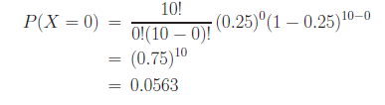
Examples
Consider an exam that contains 10 multiple-choice questions with 4 possible choices for each question, only one of which is correct. Suppose a student is to select the answer for every question randomly. Let X be the number of questions the student answers correctly. Then, X has a binomial distribution with parameters n = 10 and p = 0.25.
What is the probability for the student to get no answer correct?

Slide 66
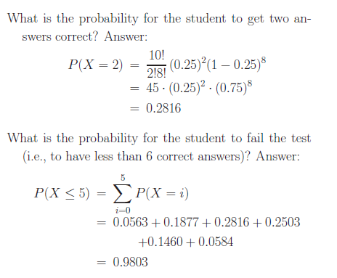

Slide 67
Mean and standard deviation
For a binomial distribution with n trials and p as the probability of success, the mean or expected value and variance of the random variable x is
For the sex distribution of n = 3 individuals, the expected number of females selected is 3 × 0.5 = 1.5 and the variance is 3 × 0.5 × 0.5 = 0.75
For the experiment of selecting 13 individuals, the mean number of those with 14-17 years of education with p=0.357 is 13 × 0.357 = 4.64, the variance is 13 × 0.357 × 0.643 = 2.984, and the standard deviation is 1.727.

Slide 68
Poisson distribution
When there is a large number of trials, but a small probability of success, binomial calculation becomes impractical. Then we can have Poisson distribution.
e ^{-µ}µ^{x}
P(X = x) =
x!
P(X) probability of getting n counts (x = 0, 1, 2,...)
μ average of distribution or parameter of distribution
For a given time interval of interest, in an application, μ can
be specified as λ times the length of that interval t. It usually is applicable in situations where random “events” occur at a certain rate over a period of time. X be the total number of events in that time interval.

Slide 69
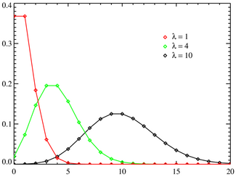
Poisson distribution of data
. Let μ= λ t ; then, μ can be interpreted as the average, or mean, number of events in an interval of length t.

Slide 70
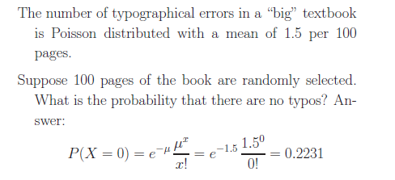
Examples

Slide 71
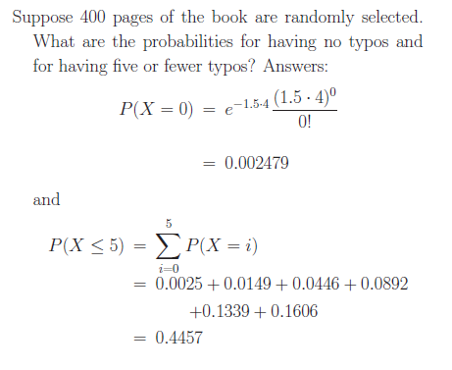

Slide 72

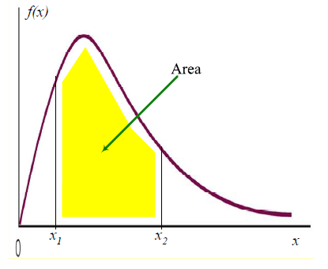

General Continuous Distributions.
A continuous random variable or distribution is defined via a probability density function. Let f(x) (nonnegative) be the density function of variable X. Then, f(x) is the rate at which probability accumulates in the neighborhood of x. In other words, for any interval
and

Slide 73

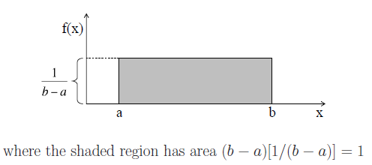
Uniform Distribution.
A random variable X is said to be uniformly distributed if its density function is given by:

Slide 74
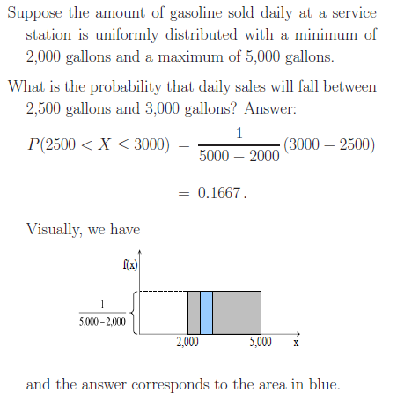

Slide 75
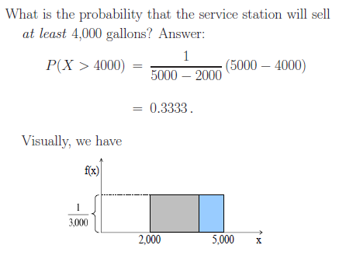

Slide 76
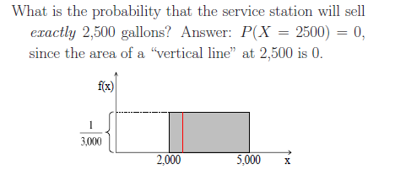

Slide 77
Normal distribution : Gaussian Distribution
Centered around the mean μ with a width determined by the standard deviation σ
It’s a probability function, so no matter what the values of μ and σ, must integrate to 1

Slide 78
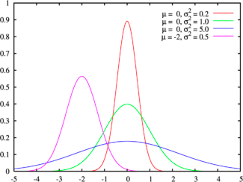
The Normal Distribution
f(X)
Changing μ shifts the distribution left or right.
Changing σ increases or decreases the spread.
σ
μ
X

Slide 79
Normal distribution in population is defined by its mean and standard dev.
μ =
Var(x) = σ² =

Slide 80
The beauty of the normal curve:
No matter what μ and σ are, the area between μ-σ and μ+σ is about 68%;
the area between μ-2σ and μ+2σ is about 95%;
and the area between μ-3σ and μ+3σ is about 99.7%.
Almost all values fall within 3 standard deviations.

Slide 81
68-95-99.7 Rule in Math terms…

Slide 82
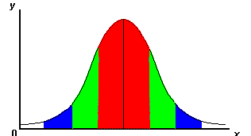
68-95-99.7 Rule
68% of the data
95% of the data
99.7% of the data
μ-3σ μ-2σ μ-σ μ μ+σ μ+2σ μ+3σ
Notes:
SAY: within 1 standard deviation either way of the mean
within 2 standard deviations of the mean
within 3 standard deviations either way of the mean
WORKS FOR ALL NORMAL CURVES NO MATTER HOW SKINNY OR FAT

Slide 83
How Do You Get μ and σ?
To draw a normal distribution μ and σ have to be known
If infinite number of measurements are made on population , their mean would be μ and their standard deviation would be σ
In practice, a finite number of measurements (sampling) are made with mean x and standard deviation s in sampled space

Slide 84
The Standard Normal Distribution Z
A normal distribution whose mean is 0 and standard deviation 1 is called the standard normal distribution. All normal distributions can be converted into the standard normal curve by subtracting the mean and dividing by the standard deviation:
The formula for the standardized normal probability density function is
Somebody calculated all the integrals for the standard normal and put them in a table! So we never have to integrate!
Even better, computers now do all the integration.

Slide 85
The Standard Normal Distribution: z score
It is tedious to ‘integrate’ a new normal distribution for every population, so a ‘standard normal distribution’ with standard tabulated areas is used.
The measurement x is converted to a standard score (z-score)
z = (x - μ) / σ = (Normal variable- Mean)/Standard deviation
Then the standard normal distribution is used for
= 0 and σ = 1
The probability distribution of z is called Standard Normal Distribution
The z-score indicates the number of standard deviations that value x is away from the mean μ

Slide 86
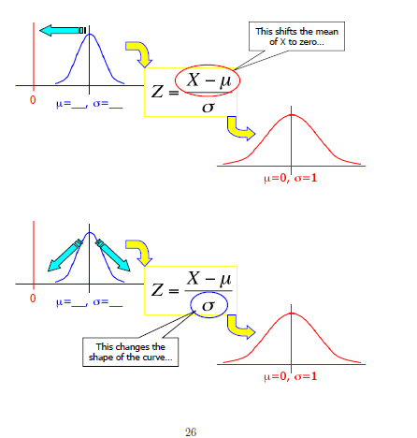

Slide 87
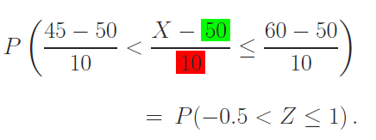
Example :
Suppose the time required to build a computer is normally distributed with a mean of 50 minutes and a standard deviation of 10 minutes. What is the probability for the assembly time of a computer to be between 45 and 60 minutes?
The problem is to compute P(45 < X ≤ 60).
1. Rewrite the event of interest into a form that is in terms of a standardized variable Z = (X −50)/10, as
2. Then use the P vs area table provided

Slide 88
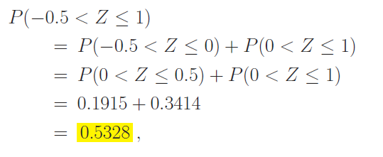
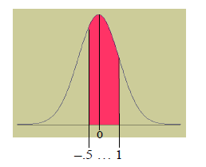
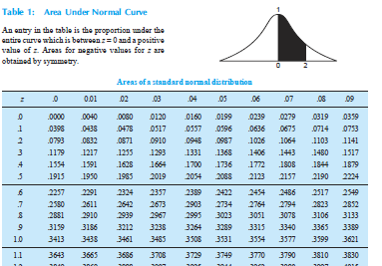

Slide 89
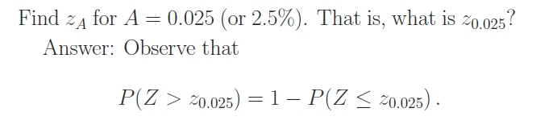
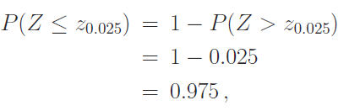
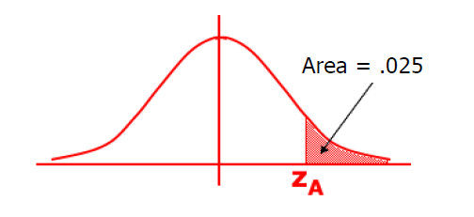
Finding “z” for Given Probability.

Slide 90
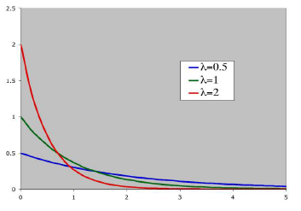

Exponential Distribution.
The exponential distribution, has the following probability density function:
This family of distributions is characterized by a single parameter λ , which is called the rate. Intuitively, λ can be thought of as the instantaneous “failure rate” of a “device” at any time t, given that the device has survived up to t.
The exponential distribution is typically used to model time intervals between “random events”.

Slide 91
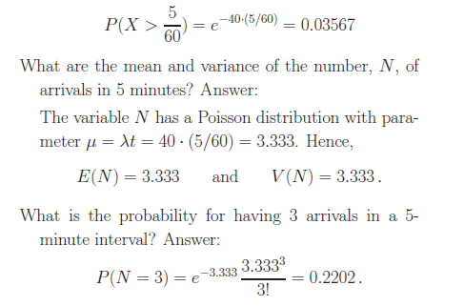
The arrival rate of cars at a gas station is λ = 40 customers per hour. (This is equivalent to saying that the inter-arrival times are exponentially distributed with
rate 40 per hour.) What is the probability of having no arrivals in a 5 minute interval?

Slide 92
Sampling Distribution

Slide 93
Sampling Distribution
Every time we take a random sample and calculate a statistic, the value of the statistic changes (remember, a statistic is a random variable).
If we continue to take random samples and calculate a given statistic over time, we will build up a distribution of values for the statistic. This distribution is referred to as a sampling distribution.
A sampling distribution is a distribution that describes the chance fluctuations of a statistic calculated from a random sample.
The probability distribution of is called the sampling distribution of the mean.
The distribution of , for a given sample size n, describes the variability of sample averages around the population mean μ.

Slide 94
Sampling Distribution Sampling distribution of a statistic, which is the distribution of all values of that statistic when all possible samples of the same size are taken from the same population. • How to find sampling distribution of sample means. • How to interpret the Central Limit Theorem. • How to apply the Central Limit Theorem to find the probability of a sample mean 1. Sampling distribution of mean 2. Sampling distribution of proportion 3. t- distribution 4. F distribution 5. Chi square distribution

Slide 95
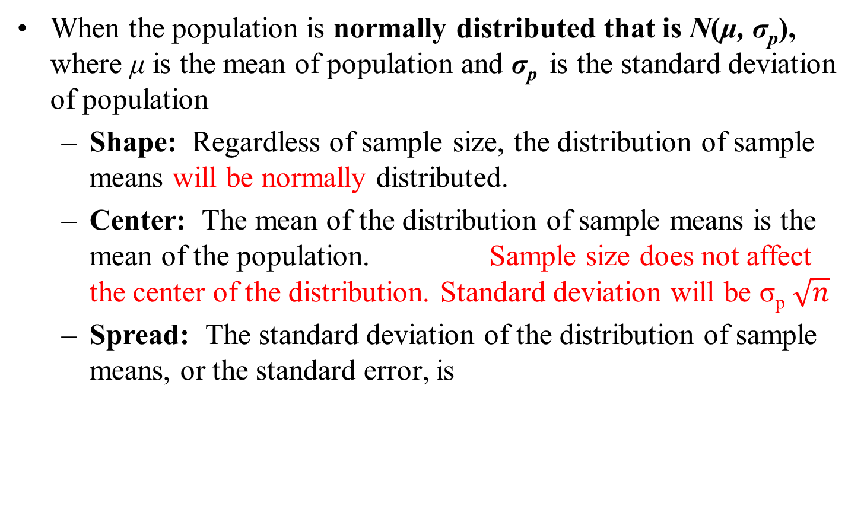
Sampling Distribution of the Mean
When the population is normally distributed that is N(μ, σ_{p}), whereμ is the mean of population and σ_{p} is the standard deviation of population
Shape: Regardless of sample size, the distribution of sample means will be normally distributed.
Center: The mean of the distribution of sample means is the mean of the population. Sample size does not affect the center of the distribution. Standard deviation will be σ_{p}$\sqrt{n}$
Spread: The standard deviation of the distribution of sample means, or the standard error, is
is called the standard error of the mean

Slide 96
Remarks
• The sample mean varies from sample to sample and is a random variable.
• As a random variable, it has a probability distribution, called the sampling distributions of the mean.
• Some sample statistics, such as mean, and proportion are good for estimating values of population parameters, whereas others such as the median do not.
• Using sampling distributions one may use sample sizes which represent a tiny percentage of the actual population, and still estimate the population parameters with reasonable accuracy.

Slide 97
Standardizing a Sample Mean on a Normal Curve
The standardized z-score is how far above or below the sample mean is compared to the population mean in units of standard error.
“How far above or below” = sample mean minus µ
“In units of standard error” = divide by
Standardized sample mean
sample
mean
μ
=
−
μ
x
–
z
=
standard
error

Slide 98
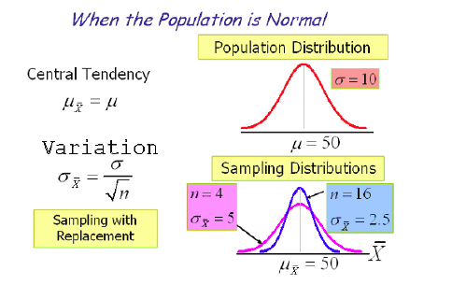

Slide 99
Central Limit Theorem (when distribution is not normal)
Given:
1. The random variable x has a distribution (which may or may not be normal) with mean μ and standard deviation σ.
2. Simple random samples all of the same size n are selected from the population. (The samples are selected so that all possible samples of size n have the same chance of being selected.)
Conclusions:
1. The distribution of sample means will, as the sample size increases, approach a normal distribution.
2. The mean of all sample means is the population mean μ, that is
3. The standard deviation of all sample means is
The standard deviation of the sampling distribution of the sample means, is also called the standard error of the mean.
σ
=
σ
.
x
n

Slide 100
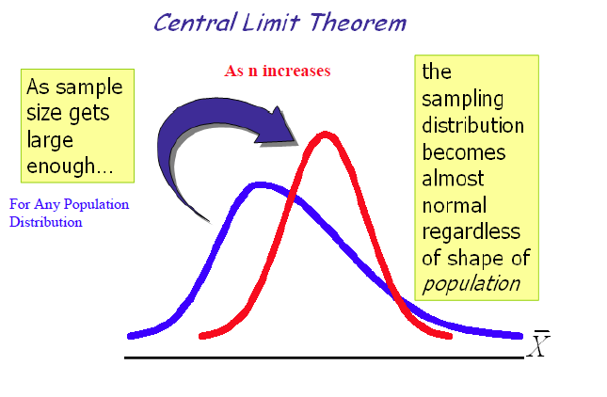

Slide 101
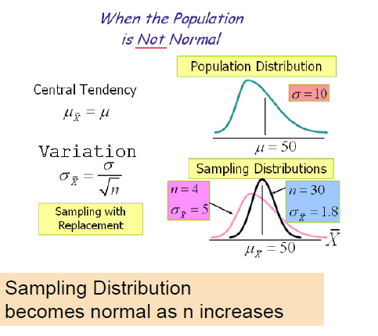

Slide 102
Example: Standardizing a Mean
When a production machine is properly calibrated, it requires an average of 25 seconds per unit produced, with a standard deviation of 3 seconds. For a simple random sample of n = 36 units, the sample mean is found to be 26.2 seconds per unit. When the machine is properly calibrated, what is the probability that the mean for a simple random sample of this size will be at least 26.2 seconds?
Standardized sample mean:

Slide 103
2. Sampling Distribution of the Proportion
When the sample statistic is generated by a count not a measurement, the proportion of successes in a sample of n trials is p, where
Shape: Whenever both n p and n(1 – p) are greater than or equal to 5, the distribution of sample proportions will be approximately normally distributed.
Center: The center of the distribution of sample proportions is the center of the population.
Spread: The standard deviation of the distribution of sample proportions, or the standard error, is

Slide 104
Example: Standardizing a Proportion
The campaign manager for a political candidate claims that 55% of registered voters favor the candidate over her strongest opponent. Assuming that this claim is true, what is the probability that in a simple random sample of 300 voters, at least 60% would favor the candidate over her strongest opponent?
π = 0.55, p = 0.60, n = 300
Standardized sample proportion:

Slide 105
Standardizing a Sample Proportion on a Normal Curve
The standardized z-score is how far above or below the sample proportion is compared to the population proportion in units of standard error.
“How far above or below” = sample
“In units of standard error” = divide by
Standardized sample proportion
Where is the sample proportion of success

Slide 106
t-Distribution
So far, we have been assuming that we knew the value of σ. This may be true if one has a large amount of experience with a certain process. If also the size is too small use t- distribution. The t-distribution is a family of distributions that is bell-shaped and symmetric like the Standard Normal Distribution but with greater area in the tails.
However, it is often true that one is estimating σ along with μ from the same set of data.
To allow for such a situation, we will consider the t statistic:
→ standard error of the mean

Slide 107
F distribution
are the variances of two independent samples of size n₁ and n₂ taken from two independent normal populations having same variance, that is
and
then
F distribution is computed in a way that the larger variance is always in the numerator and can be obtained from F table.

Slide 108
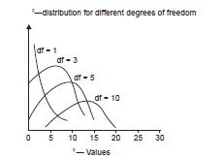
Chi-square distribution
A random variable x is normally distributed having mean μ with variance σ² and s² is the sample variance then a random variable
said to follow Chi-square distribution
n is a positive number called degree of freedom
The distribution curve is not symmetric and has +ve skew

Slide 109
Chi-square distribution (non-parametric)
Chi-square distribution is used when we deal with collection of values which require adding up of squares
1. Suppose there are n observations.
2. Each observation falls into a cell (or class).
3. Observed frequencies in each cell: O₁, O₂, O₃, … , O_{k}.
Sum of the observed frequencies is n.
4. Expected, or theoretical, frequencies: E₁, E₂, E₃, . . . , E_{k}.

Slide 110
Test for goodness of a fit
1. Suppose there are n observations.
2. Each observation falls into a cell (or class).
3. Observed frequencies in each cell: O₁, O₂, O₃, … , O_{k}.
Sum of the observed frequencies is n.
4. Expected, or theoretical, frequencies: E₁, E₂, E₃, . . . , E_{k}.

Slide 111
Example
A die is thrown 60 time with the following results
Face | 1 | 2 | 3 | 4 | 5 | 6 | Total
Frequency | 6 | 10 | 8 | 13 | 11 | 12 | 60
“die is unbiased”. Then the probability of each face is 1/6, and the expected frequencies is 60x1/6= 10 each.
Expected frequency | 10 | 10 | 10 | 10 | 10 | 10 | Total
Observed Frequency | 6 | 10 | 8 | 13 | 11 | 12 | 60
 | 16 | 0 | 4 | 9 | 1 | 4

Slide 112
Sampling Error
Sampling error -single mean
The difference between a value (a statistic) computed from a sample and the corresponding value (a parameter) computed from a population.
Sampling Error is inherent in any sampling process due to the fact that samples are only a subset of the total population.
Sampling Errors depends on the relative size of sample
Sampling Errors can be minimized but not eliminated.

Slide 113
Estimation
Estimation (Inference) is assessing the value of a population parameter using sample data
Two types of estimation:
Point Estimates
Interval Estimates
Most common point estimates are the descriptive statistical measures.
If the expected value of an estimator equals to the population parameter then it is called unbiased.

Slide 114
Estimation
This indicates that we can use sample estimates as if they were population parameters without committing an error.

Slide 115
Interval Estimate provides a range within which population parameter falls with certain likelihood.
Confidence Level is the probability (likelihood) that the interval contains the population parameter. Most commonly used confidence levels are 90%, 95%, and 99%.
Confidence Interval (CI) is an interval estimate specified from the perspective of the point estimate.
In other words CI is
an interval on either side (+/-) of the point estimate
based on a fraction (t or z-score) of the Std. Dev. of the point estimate

Slide 116
Confidence Intervals
Lower Confidence Limit
Upper Confidence Limit
Point Estimate
95% Confidence Intervals
0.95
Normalized Z
z_{.025}= -1.96
z_{.025}= 1.96
The z-score indicates the number of standard deviations that value x is away from the mean μ

Slide 117
Estimates of population mean
The relation between dispersion of a population distribution and that of the sample mean is given as,
Standard deviation of population
Standard error of mean for a given sample size
But we do not have any information of population so how can we know σ_{p}
Best estimates is to take the standard deviation of sample σ_{s}

Slide 118
A random sample of 36 Professor of CU, the mean age = 40 and sample standard deviation =4.5. Construct 95% Confidence interval of mean age of Professors in CU. So, given n=36 and σ= 4.5 and at 95% CI, z=1.96. Mean age of population
Estimating population mean
This normal distribution is used when sample size is large and standard deviation of population is known.

Slide 119
In a random selection of 64 of the 2400 intersections in a small city, the mean number of scooter accidents per year was 3.2 and the sample standard deviation was 0.8.
(1) Make an estimate of the standard deviation of the population from the sample standard deviation.
(2) Work out the standard error of mean for this finite population.
(3) If the desired confidence level is .90, what will be the upper and lower limits of the confidence interval for the mean number of accidents per intersection per year?
The given information can be written as under:
N = 2400 (This means that population is finite) ; n = 64 ; and
and the standard variate, z for 90 per cent confidence is 1.645 (as per the normal curve area table).

Slide 120
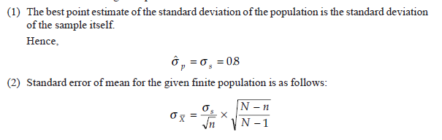
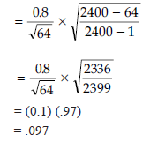

Slide 121
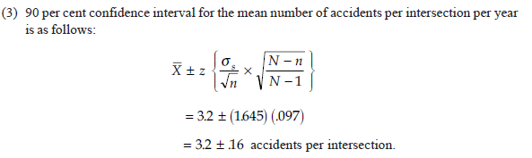

Slide 122
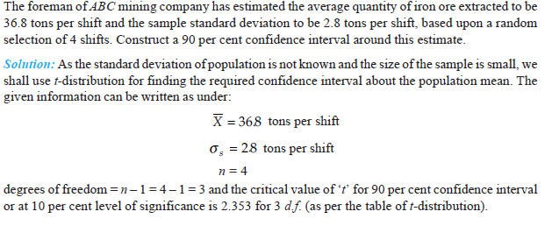
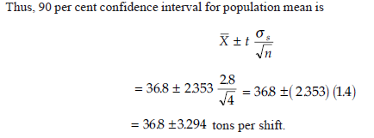

Slide 123
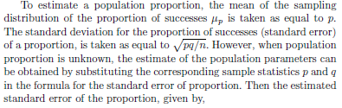


Estimating population proportion

Slide 124
Estimation of sample size for an acceptable error
Sample size when estimating a mean (say for normal distribution
Confidence interval for population mean μ is
Z value for 95% confidence interval is 1.96
Say σ_{p} ⁼ 4.8 and e= 3,
Acceptable error e
n= 9.8 =10
In general for large population,
For finite population, confidence level for µ is

Slide 125
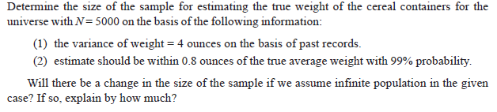
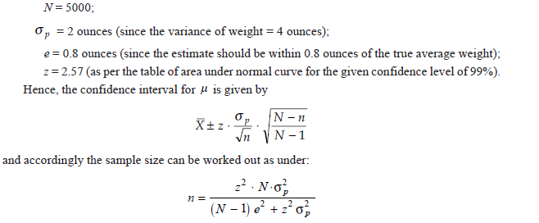

Slide 126



Slide 127


Sample size when estimating a proportion

Slide 128


Slide 129


